Slide 1
Student Handbook/
Time Management
Temple College
Continuous Orientation
Notes:
Let’s take a minute to discuss the student handbook and some time management tips.

Slide 2
Student Handbook
The Temple College Student Handbook details the many services, resources and activities available at Temple College. The handbook is designed for use as a reminder to returning students and as a guide for new students.
It is a “rulebook,” a source of information provided to help you understand what is expected of you as a student and what is expected of your peers and Temple College faculty and staff.
The Handbook is not intended to be comprehensive. Instead, vital information is presented, and, when necessary, the Handbook refers to other publications that can provide more detailed information (i.e., the Temple College website, located at www.templejc.edu.) Future changes may supersede policies published in the handbook.
Notes:
The Student Handbook is a rulebook that is a source for information on what is expected of you, your peers and Temple College Faculty and staff. This is not a comprehensive source of information and the information is subject to change at anytime. Check the College Website www.templejc.edu for any future changes.

Slide 3
Students right to know act and Campus security act
In compliance with the Student Right-to-Know and Campus Security Act, 20 USC 1092 (a), (e), (f), as amended, Temple College collects annual information on campus crime statistics, campus security policies, and institutional completion or graduation rates. In addition to graduation rates of students, the college will issue timely warnings to the campus community of crimes considered to pose an ongoing threat to students and employees. Temple College will also maintain a public crime log of all crimes that occur on campus or within the patrol jurisdiction of the campus police that are reported to the campus police.
Notes:
The Jeanne Clery Disclosure of Campus Security Policy and Campus Crime Statistics Act (Clery Act), as a part of the Higher Education Act of 1965, is a federal law that requires colleges and universities to disclose certain timely and annual information about campus crime and security policies.
The Clery Act requires colleges and universities to publish an annual report every year by October 1 that contains three years of crime statistics and certain policy statements including sexual assault policies, which assure basic victims’ right, the law enforcement authority of campus police, and where the students should go to report crimes.

Slide 4

The Student Resource Guide and Calendar
Notes:
The Student Resource Guide and Calendar has important dates and campus information. The guide can help you find information you need about classes and registering as well as campus activities. The Master Calendar is perfect for scheduling your work and due dates throughout the semester.

Slide 5
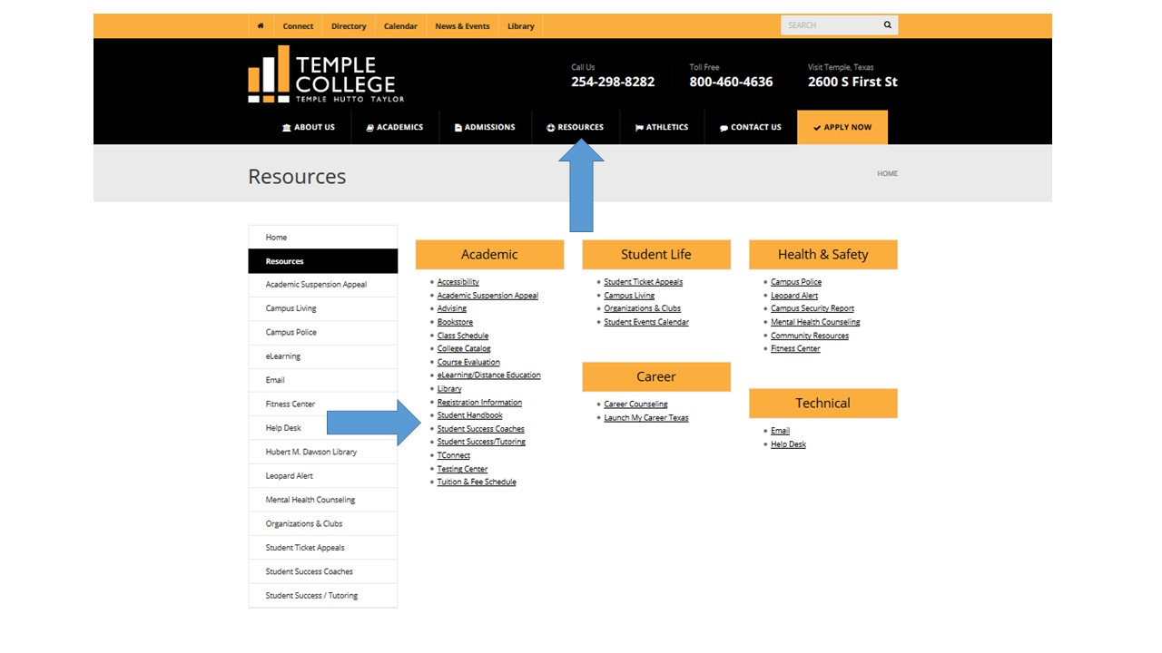
Access the most up to date handbook
Notes:
To access the current Student Handbook go to the Temple College Homepage www.templejc.edu. Hover over resources then click on student handbook.

Slide 6




Time Management
Use a Master Calendar and stick to it.
Schedule your study time.
Turn off your devices.
Eliminate “Black Holes” of time.
LEARN TO SAY “NO”
Notes:
1 Use a master calendar and put everything you have going on during the semester. Your professors and instructors will provide you with a class syllabus. This syllabus will include all important dates for class, when assignments are due and what those assignments are worth. Put these dates on your master calendar. The Student Resource Guide and Calendar is perfect for a master calendar, but you can use whatever you want as long as you use it and stick to it.
2 Schedule your study time just like you would any other activity. A good rule of thumb is for every hour you are in class per week study for at least 3 hours outside of class for that class. If your taking a full course load of 12 hours that would be 36 hours of study meaning 48 hours of effort you put towards classes per week. That’s like a full time job by itself.
3 Devices can be very distracting. Having cell phones, email, text etc. can make it difficult to concentrate on study time. Turn these devices off or leave them in another room. They will still be there when you return. Study breaks are important so check messages during scheduled breaks.
4 Great you have studied hard for 45 to 50 minutes and its time for a quick 10 minute break. You check your phone and 3 hours later your back to studying. You just got sucked into the Cell Phone Black Hole. Don’t let distractions, devices, friends, pets, family or anything else take you away from your scheduled activities. Make sure everyone knows to respect your time and effort.
5-6 Finally, Learn to say no. Family, friends, pets and others will want you to come out and play. If you have class or study time scheduled say no not at this time. Let them know when you are available to spend time with them.
Remember, when its time to study, study. However, don’t forget others do want and deserve your time. You deserve a break as well. Spend time working out, with friends and at activities, but stick to your schedule and you will be successful.

Slide 7

Success starts here
Notes:
Questions?

